Slide 1


Adoption Review
and CSM Progress Check
16th October 2024
To Replace People Image:
Access the Sample Slide Presentation on Sharepoint and Copy/Paste the image featuring people of your choice into your presentation.

Slide 2




Adoption Review
Network Rail
Products in Scope:
Sourcing+
Contracts
Supplier Management+
Adopt
Premium
A view to comparing performance benchmarked earlier in 2024 to today

Slide 3
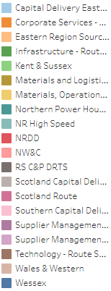
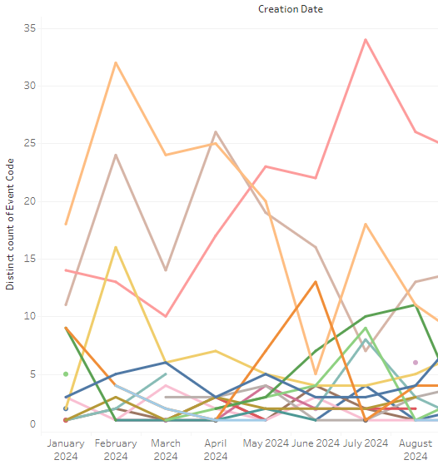
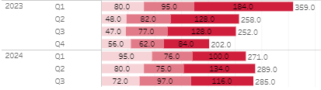
Sourcing+ Adoption Review
Sourcing Events (PQQs/ITTs) have increased every quarter in 2024
Prediction of a 5% increase over 2023
The trailblazers – North West & Central

Slide 4
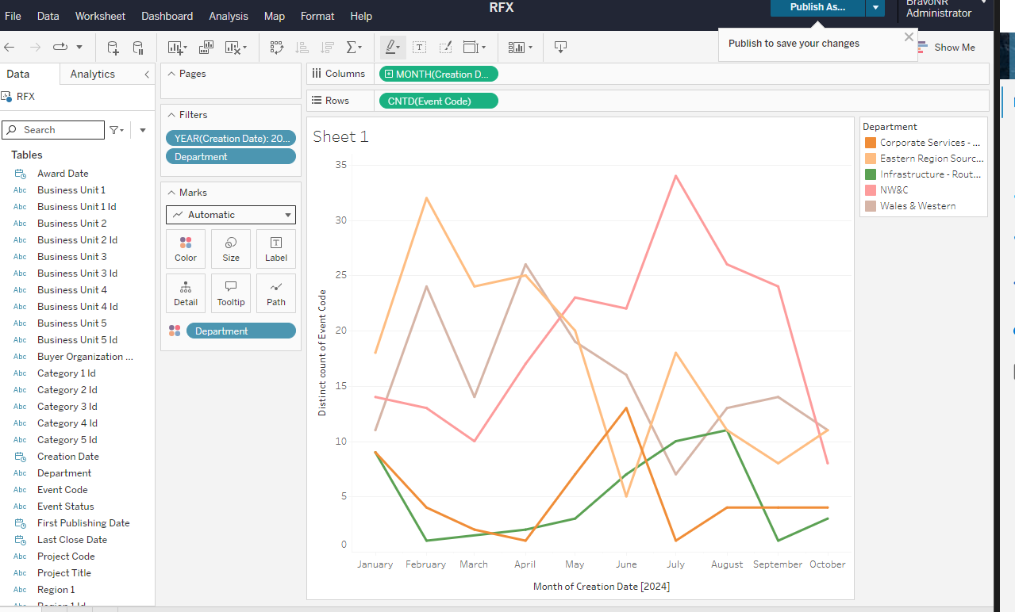
Sourcing+ Adoption Review

Slide 5
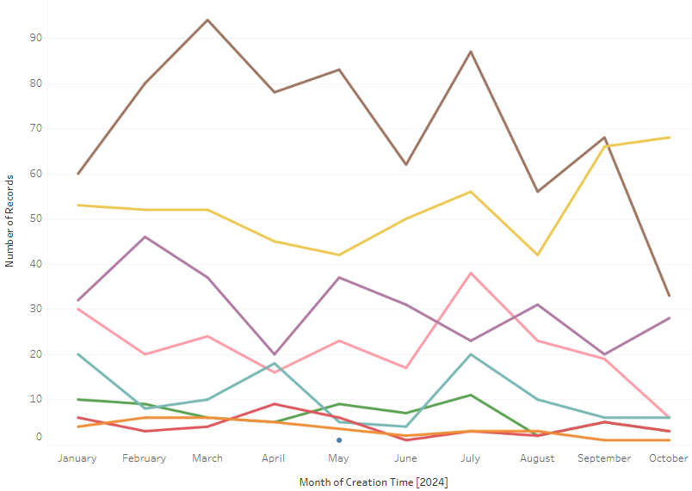
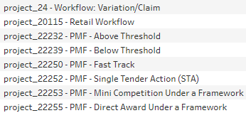
Sourcing+ Adoption Review
NR launched a fast-track project template in May
Planned Project template changes to be compliant with TPP changes next February
Opportunity – the RFx Wizard?

Slide 6
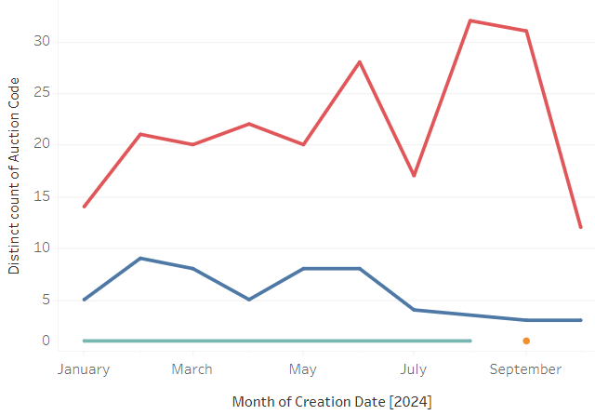
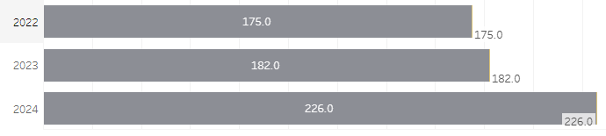
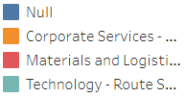
Auction Usage
Auctions deliver significant value to NR
24% increase so far in 2024 and predicted to be 93% total increase over 2023

Slide 7
Sourcing+ - Activated Features in 2024 JAGGAER Releases
JAGGAER CSM held review meetings following each release to educate and inform on the new features, with a NR specific viewpoint
Some examples of those features activated
Ability to recall messages to suppliers
Folder upload functionality for attachments
Evaluation group setup simplification
Ability to skip workflow confirmation screens in Workflow
NR launched Internal comms to highlight the value of the new features

Slide 8
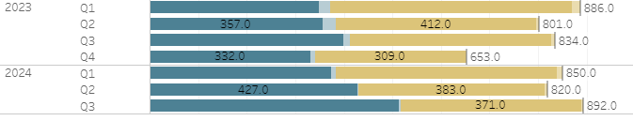
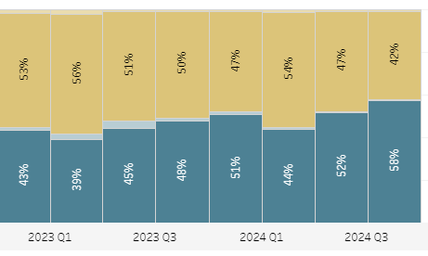
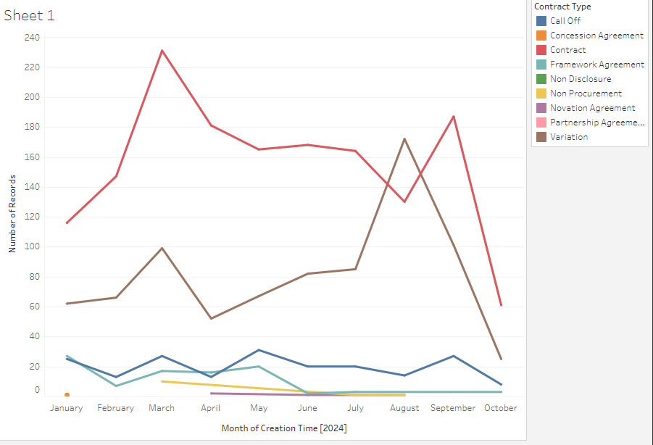
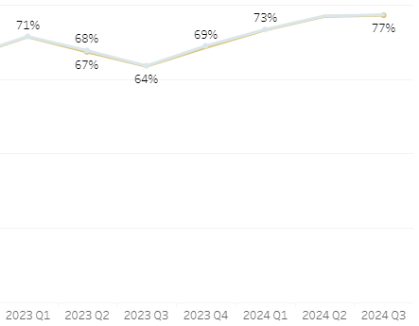
Contracts Adoption Review
New Contracts have increased Q1 and Q3 2024
Prediction of an 8% increase over 2023
Main increase is in variations
Template use has increased every Q – 58% in Q3 2024 – still an opportunity to increase RFx becoming a contract
Docusign has increased every Q – 77% in Q3 2024

Slide 9
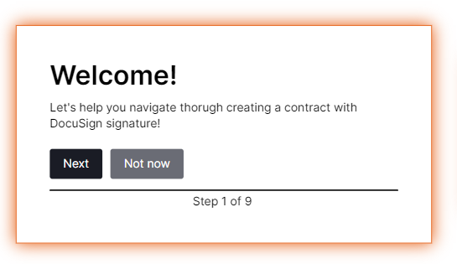
Adopt Premium
TPP was discussed to be the catalyst to get started with the first Adopt guides in production
Also, around the rebrand and relaunch
New plan to be discussed

Slide 10
Success Plan - Topics
2024 into 2025
# | Priority | Status | Objective
1 |  |  | Post contract reporting Report on KPIs and Contract performance using Scorecards in JAGGAER
2 |  |  | Complete the Rebrand and Relaunch Agree timeframe for JAGGAER PS support
3 |  |  | Take JAGGAER Adopt into use
4 |  |  | TPP Regulation Changes – Inform and support through the changes
5 |  |  | Others?

